Slide 1

Football player and coach salary exploration
Muxin Hua
Jose Guilherme Cesario
Nannan Wang

Slide 2
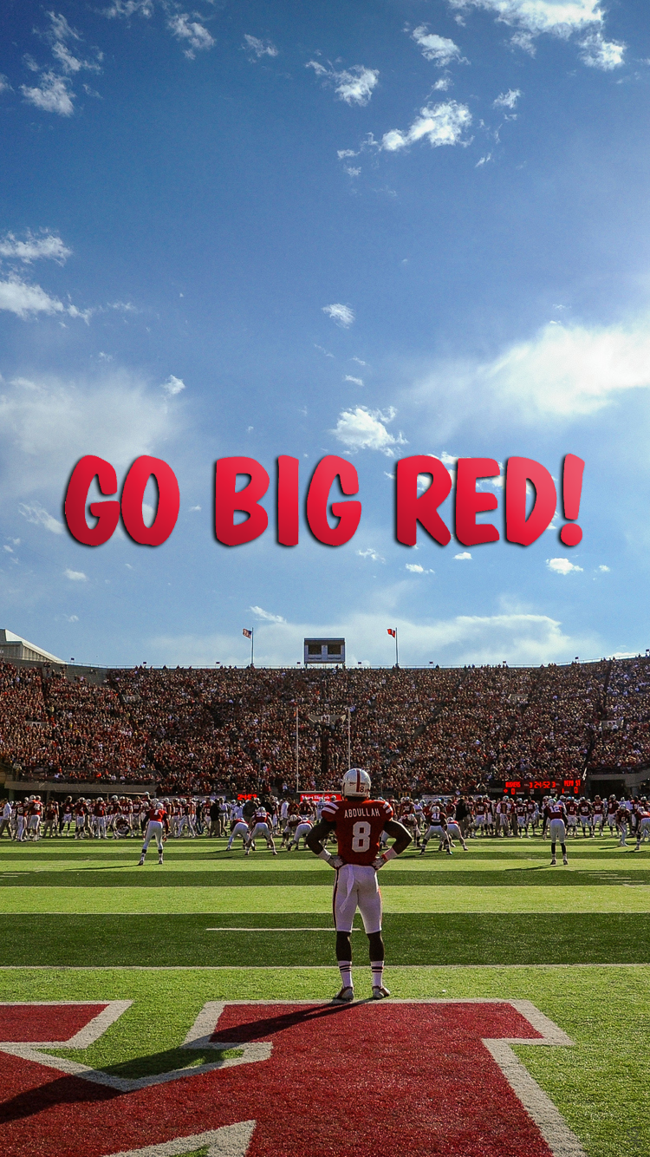
Go-Big-Red
Notes:
This project would explore three datasets including 2019 American football player salary, coach salary, and coach record. American football is a very popular game in the United States. Since all members in our team are international students and we are not familiar with this game, we are excited to explore and learn about American football.
I did go to the stadium to watch several games in 2018 before the pandemic hit. It was a fun and exciting experience. I was impressed by the size of the stadium. It’s phenomenal when all audience in the stadium shouting “Go-Big-Red” to support the Cornhuskers players!

Slide 3
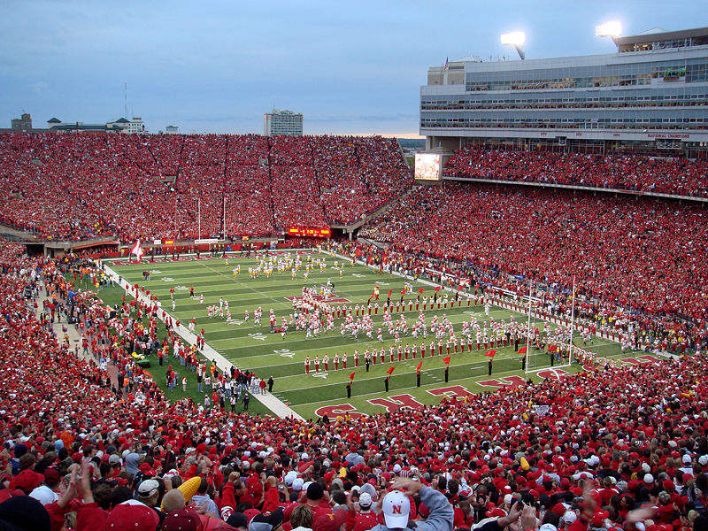
Stadium
Memorial Statium
Notes:
This is the memorial stadium. Each game would happen here. It’s crowed with people everytime!

Slide 4
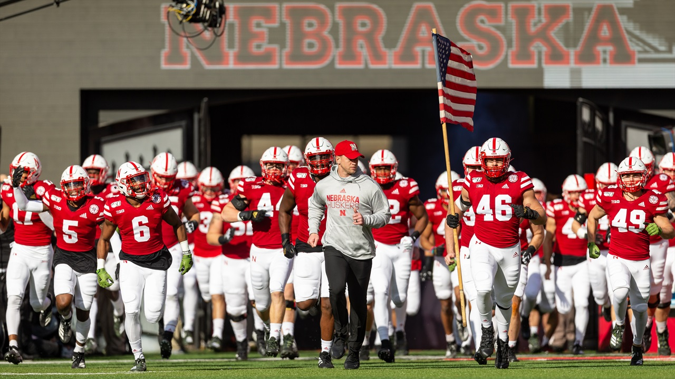
Nebraska Cornhuskers Team
Coach and Players
Notes:
This the coach, Scott Frost and the cornhuskers players

Slide 5
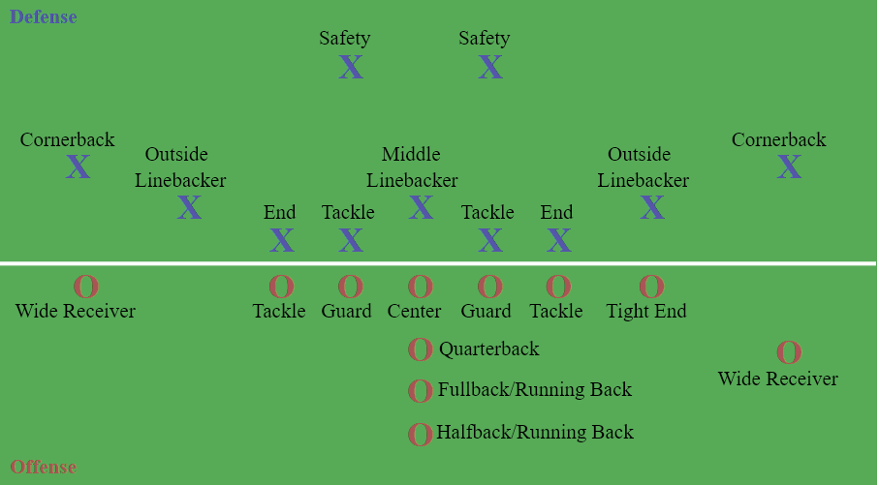
American Football Positions
Notes:
Each team has two groups of players, one Defense and Offense. There are 11 players on the offense and 11 players on the defense. During teach play, there are 22 players on the field. The offense uses its 11 players to score points against the 11 defensive players.

Slide 6
DataSets
Player Salary
Coach Salary
Coach Record
Notes:
We found these three datasets available online, Player Salary, Coach Salary, and Coach Record. Not all our datasets are from the same year. If we look at the time range of contracts, most of them are valid for 5 years, so we assume the situations don't change much in few years in the field, which justifies the conclusions from these datasets.

Slide 7
Player Salary Variables
Position: position played by the player Player: name Team: team the player in Age: age Total_Value: total amount of money on the contract Ave_Year: yearly averaged salary Total_guaranteed: players could get this amount of money after they serve several years for the team Fully_guaranteed: money guaranteed to get regardless of what happens Free_agency: time when the contract of the player expires
Notes:
In the player salary dataset, there are several variables introducing each player’s name, position and which team the player is from. In addition, there are variables related to the value of the players, such as average salary per year, total guaranteed which is the amount of money after they serve several years for the team, fully guaranteed which is the money guaranteed to get regardless of what happens.

Slide 8
Coach Salary Variables
name: name of the coach team: team the coach works for division: division of the team annual salary: annual salary net worth: Total sum of property position: position of the coach
Notes:
Variables in the Coach salary dataset are name of the coach, which team the coach work for, division of the team, each coach’s annual salary, total sum of property, and position of the coach.

Slide 9
Coach Record Variables
name: name of the coach Team: team the coach works for seasons: seasons the coach coaches Gms: games Coached W: games Won L: games Lost T: games Tied Yrs: seasons as head coach post: number of postseason appearances as head coach pct: winning Percentage DIV: division Championships CON: conference Championships LG: league Championships SB: super Bowl Championships
Notes:
In the Coach Record variables, variables include name of the coach, team which the coach works for, seasons the coach coaches, games the coach coached, number of games won, number of games…

Slide 10
Average salary of each position
player_salary <- read.csv("PlayerSalary.csv",header = T) posSa <- player_salary %>% group_by(player_salary$position) %>% summarise(avg <- mean(total_value)) posSa <- as.data.frame(posSa) posSa[order(posSa$`avg <- mean(total_value)`,decreasing=T),]
## player_salary$position avg <- mean(total_value) ## 18 quarterback 19969326 ## 8 edge-rusher 11647101 ## 13 left-tackle 11013873 ## 1 4-3-defensive-end 10994316 ## 7 defensive-line 9107187 ## 16 offensive-line 9006569 ## 20 right-tackle 8307251 ## 4 center 8110696 ## 19 right-guard 8096270 ## 3 4-3-outside-linebacker 8013763 ## 12 left-guard 7955430 ## 10 interior-defensive-line 7685334 ## 5 cornerback 7437160 ## 24 wide-receiver 6806289 ## 6 defensive-back 6742654 ## 2 4-3-defensive-tackle 6382798 ## 14 linebacker 6307806 ## 22 safety 5828116 ## 11 kicker 5640782 ## 23 tight-end 4951559 ## 17 punter 4773773 ## 21 running-back 4741030 ## 9 fullback 3532030 ## 15 long-snapper 2448724
Notes:
This slide shows that quarterback position has the highest average salary. Positions like quarterback, edge-rusher, tackle, and 4-3-defensive-end positions make over 10 millions.

Slide 11
Number of players of each position
frequency <- player_salary %>% group_by(player_salary$position)%>% summarise(n = n()) frequency <- as.data.frame(frequency) frequency[order(frequency$n,decreasing = T),]
## player_salary$position n ## 14 linebacker 837 ## 6 defensive-back 548 ## 16 offensive-line 489 ## 7 defensive-line 426 ## 24 wide-receiver 383 ## 5 cornerback 314 ## 10 interior-defensive-line 271 ## 1 4-3-defensive-end 248 ## 22 safety 233 ## 8 edge-rusher 218 ## 21 running-back 197 ## 3 4-3-outside-linebacker 196 ## 23 tight-end 195 ## 2 4-3-defensive-tackle 181 ## 18 quarterback 119 ## 13 left-tackle 111 ## 19 right-guard 108 ## 20 right-tackle 100 ## 12 left-guard 97 ## 4 center 90 ## 17 punter 46 ## 11 kicker 44 ## 15 long-snapper 42 ## 9 fullback 22
Notes:
There are 837 linebackers a part of defense which is responsible to stop both the run and pass. Their position is in the middle of the defense. From this slide, we can see that teams tend to have more players in defense. Wide-receiver is the position in the offense that has the largest number of players.

Slide 12
Average salary of each team
teamSa <- player_salary %>% group_by(player_salary $team) %>% summarise(avg <- mean(total_value)) teamSa <- as.data.frame(teamSa) teamSa[order(teamSa$`avg <- mean(total_value)`,decreasing=T),]
## player_salary$team avg <- mean(total_value) ## 32 Vikings 11155185 ## 2 Bears 9636364 ## 1 49ers 9494696 ## 6 Browns 9013063 ## 26 Redskins 8943277 ## 20 Packers 8803744 ## 14 Eagles 8685926 ## 17 Jaguars 8538031 ## 31 Titans 8362323 ## 19 Lions 8296689 ## 12 Cowboys 8199380 ## 24 Rams 8137855 ## 18 Jets 8057762 ## 7 Buccaneers 8001185 ## 27 Saints 7974497 ## 30 Texans 7913402 ## 10 Chiefs 7903397 ## 3 Bengals 7876623 ## 29 Steelers 7725859 ## 5 Broncos 7713818 ## 21 Panthers 7706132 ## 15 Falcons 7489312 ## 8 Cardinals 7394046 ## 23 Raiders 7207824 ## 16 Giants 6765498 ## 4 Bills 6605455 ## 22 Patriots 6597065 ## 9 Chargers 6349936 ## 11 Colts 6151609 ## 25 Ravens 5996525 ## 28 Seahawks 5559518 ## 13 Dolphins 5402191
Notes:
This slide shows that the team Vikings earns the most in terms of the total value which is the amount of money on the contract.

Slide 13
Average salary of each age group
ageSa <- player_salary %>% group_by(player_salary $age) %>% summarise(avg <- mean(total_value)) ageSa <- as.data.frame(ageSa) ageSa[order(ageSa$`avg <- mean(total_value)`,decreasing=T),]
## player_salary$age avg <- mean(total_value) ## 21 40.00000 50000000 ## 23 42.00000 41000000 ## 19 38.00000 34395714 ## 11 30.00000 26115448 ## 12 31.00000 24368405 ## 15 34.00000 21186348 ## 10 29.00000 19782340 ## 17 36.00000 16293077 ## 9 28.00000 16011379 ## 13 32.00000 15152429 ## 16 35.00000 14556389 ## 18 37.00000 14531400 ## 14 33.00000 13254022 ## 8 27.00000 9408572 ## 6 26.00000 6546534 ## 2 22.00000 4564270 ## 1 21.00000 4433961 ## 5 25.00000 4293364 ## 24 47.00000 3875000 ## 3 23.00000 3364737 ## 4 24.00000 3269501 ## 7 26.07252 3145965 ## 20 39.00000 2350000 ## 22 41.00000 1120000
Notes:
From this slide, we can see that players around 40 years old earn the most compared to younger players.

Slide 14
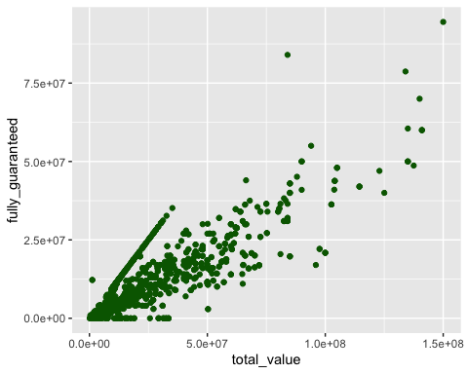
Is total value positively correlated with fully guaranteed?
## [1] 0.9111312
Notes:
In this slide, a correlation between fully_guaranteed and total_value is explored. We could see from the scatter plot that there's a positive correlation between these two variables. And the correlation is calculated which is equal to 0.911.

Slide 15

What are the variables related to high annual salary of players?
Position - Average income - top-income players
Age
- Top-income Players Age Distribution - Overall-income Players Age Distribution
Team
- How annual salary varies with team - Ram Cowboy and overall average
Notes:
Thank you nannan. Instead of player’s accumulative fortune, I will show how their annual salary related to position age and team they play for.

Slide 16
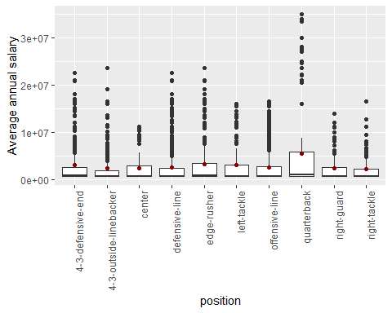
Position
Average income
Outliers : extraordinarily highly paid players
highest averaged yearly pay : quarterback
Notes:
Let’s first start with position. I take the average over annual salary of each position and rank them by values. Actually, there are 24 positions available in the data, but we’ll only show the top 10 positions.
If we look at this box plot, the quartiles are scaled by large outliers, they are meaningful so we cannot just remove them, we will talk about them soon. Let’s see zoom in to take a closer look.

Slide 17
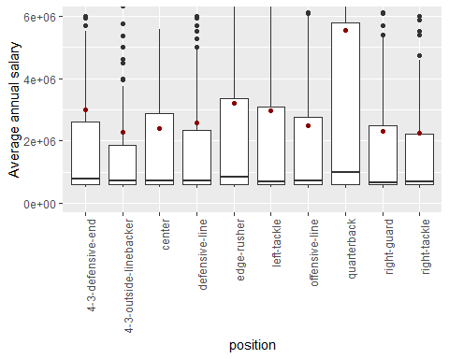
Position
Zoom in
quarterback : almost 6 million
4-3 outsider linebacker : still top 10/24
Notes:
we can see quarterback has the highest value, which is getting close to 6 million, which could be twice of the number of 4-3 outside linebacker,
but notice 4-3 outsider linebacker looks like the least in this plot, but we actually have 24 positions, so they are actually high-paid position.

Slide 18
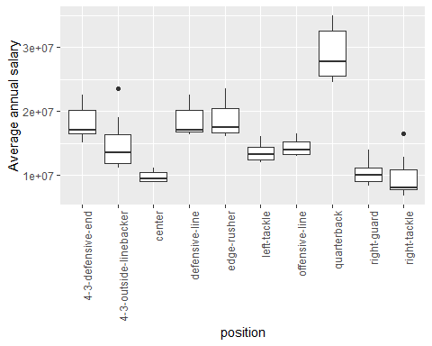
Position
Top highest in each position
quarterback : still the highest yearly pay
Notes:
Now we move to the outliers mentioned before, they are actually extraordinarily highly paid players .
So I took the top 10 paid player in each position and take their average value to plot this.
If we compare with the previous plot, we find the trend are quite similar and quarterback still has the highest salary.

Slide 19
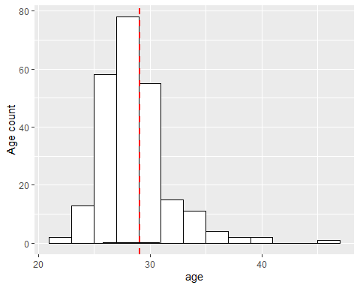
Age
Top-paid Distribution
Most in 25-31
mean around 29
Notes:
As for age, There might be a trade off. younger players are energetic but older players could be experienced. It would be nice to show if there’s an optimal age.
So I look at the age distribution of the top 10 paid players in each position.
We can tell that most of the players have age between 25 and 31. The mean age is somewhere around 29, a very slight right tail.

Slide 20
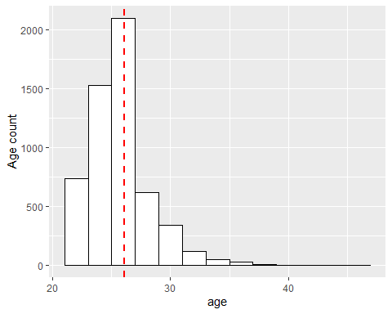
Age
Overall distribution
Heavy right tail
In general, younger is preferred
Notes:
I also want to know the age preference of all player so I generate this plot,
This time the average goes down to 26, and has a very heavy right tail.
That’s understandable because age is not guaranteed for good performance.

Slide 21
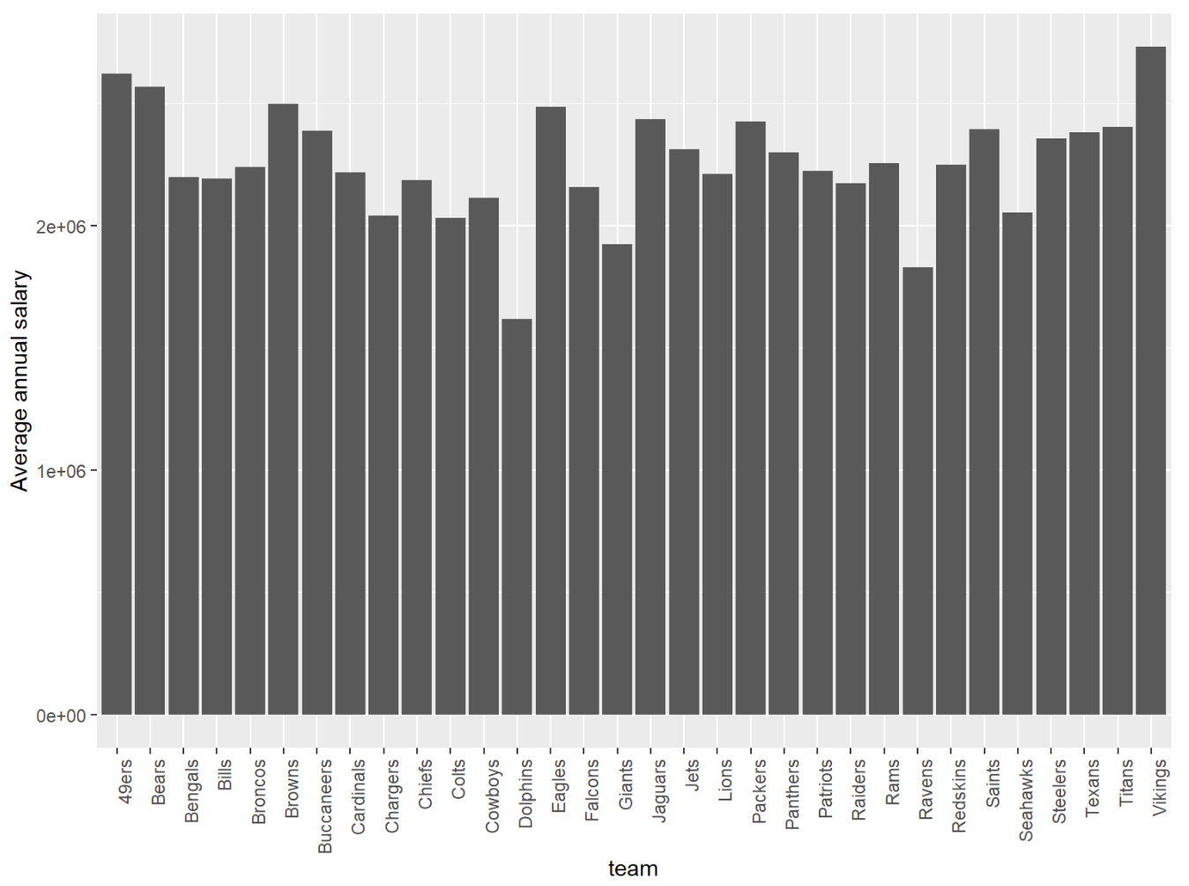
Team
Barplot to compare teamwise
most: between 2 million and 2.5 million
Dolphins and Ravens
Notes:
Besides age and position, I think it’s fun to show is there any team tend to pay more to their players.
So I plot this to show how average annual salary varies by team.
The average values fluctuate between 23 million and 2.5 million without any obvious peak but definitely two valley: Ravens and Dolphins,
I kind of want to know how they are different from the rest of the teams.

Slide 22
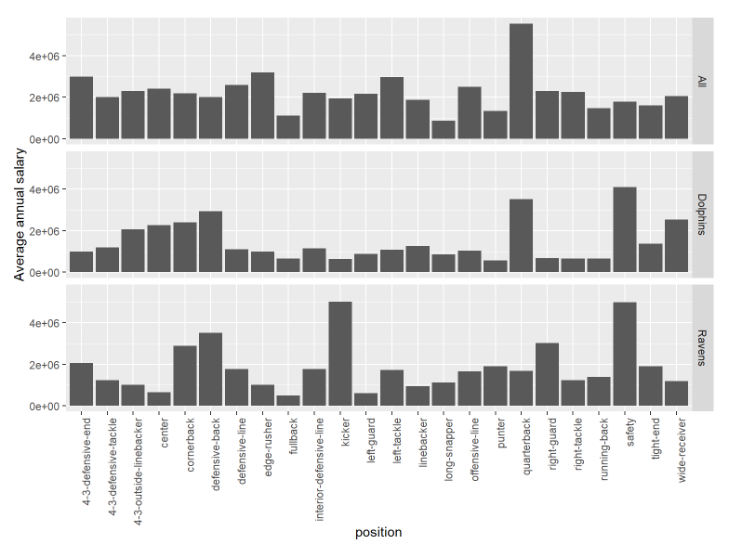
Team
Ram, Cowboy and all
all: most paid position quarterback
Dolphins and Ravens: safety
Notes:
So I generate this plot to show position invest strategy of Dolphins, Ravens and the rest of the teams.
These distributions are different in their own way, but there is a position both dolphins and ravens like to pay more, that is safty.
To talk about our next topic, we have Jose.

Slide 23
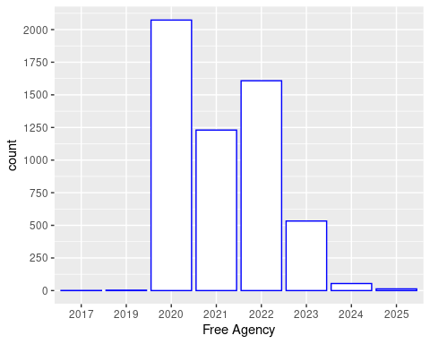

Free agency players x Year
There will be ~5,000 free agency players by 2022
Notes:
Hello everyone, as Muxin mentioned, my names is Jose Cesario and I will lead the presentation from here. Therefore, as showed on the ppt slide now, we have a graph with the number of free agency players per year. As Nannan explained earlier, free agency means that these players will be free to negotiate with another teams by the year that their contract ends. As we can see in the graph, there will be almost 5,000 free agency players by 2022, and that is taking in count from 2017 to 2022. Also, the figure is showing that there is a trend on decreasing the number of free agency players from 2020 to 2025. This trend might be due to a lot of players that are ending their contract to start a new one.

Slide 24

20 MVP list
## player position team ## 1 Matt Ryan quarterback Falcons ## 2 Russell Wilson quarterback Seahawks ## 3 Aaron Rodgers quarterback Packers ## 4 Kirk Cousins quarterback Vikings ## 5 Matt Stafford quarterback Lions ## 6 Khalil Mack 4-3-outside-linebacker Bears ## 7 Aaron Donald defensive-line Rams ## 8 Andrew Luck quarterback Colts ## 9 Jimmy Garoppolo quarterback 49ers ## 10 Alex Smith quarterback Redskins ## 11 Derek Carr quarterback Raiders ## 12 Demarcus Lawrence defensive-line Cowboys ## 13 Von Miller 4-3-outside-linebacker Broncos ## 14 Joe Flacco quarterback Broncos ## 15 Frank Clark defensive-line Chiefs ## 16 Trey Flowers defensive-line Lions ## 17 Odell Beckham, Jr. wide-receiver Browns ## 18 Philip Rivers quarterback Chargers ## 19 Eli Manning quarterback Giants ## 20 Cam Newton quarterback Panthers
Notes:
On this slide we have a list of the 20 MVP, which stands for the 20 Most Valuable Players from the NFL league. For that, we considered all the values from the dataset. For instance, avg_year, total_guaranteed, fully_guaranteed

Slide 25
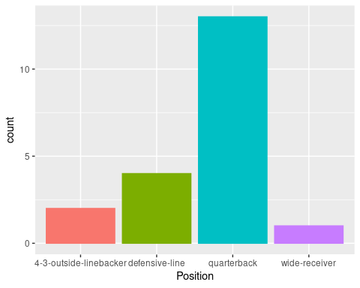

Position x MVP’s
The position that shows more MVP’s is the quarterback.
Notes:
As I mentioned before, the position that has more MVP’s based on our dataset is the quaterback, followed by the defensive line, 4-3-outside linebacker and finally wide-receiver. Which we were expecting that because the quaterbacks are the ones responsible for creating plays for all the team when they are attacking and that’s the way to scores on this game.

Slide 26
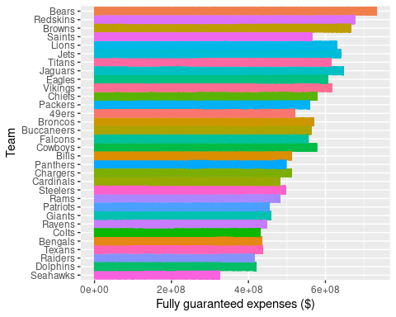

Teams x Fully Guaranteed Expenses
The Bears team has the highest fully guaranteed expenses (~4,2 M dollars), followed by Red Skins (~4,1 M dollars) and Browns (~3,8 M dollars).
Notes:
On this graph we can see that the teams that are showing higher fully guaranteed expenses which is the money that the teams will spend with players regardless of what happens. As we can see,........... We were kind of surprised with this data because, I would imagine that the teams which won the superbowl in the last three years (patriots and chiefs, or even tampa bays) would be the ones with more expenses due to higher investments.
money guaranteed to get regardless of what happens

Slide 27
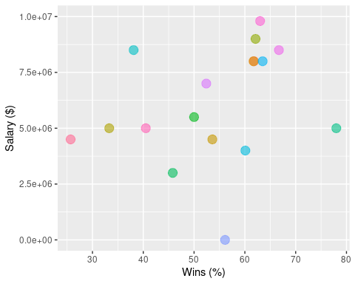

Coach Wins x Salaries
Notes:
Finally, here we have some relationship betweeen coach records wins and their salaries, where we were trying to find a trend on that. Because we would expect that the percentage of wins per number of games from this coaches would be highly related on how much money they make. However, as we can see in the graph we have no clear trend on this relationship. The coach salaries ranged from 2.5 million to 10 million if we dont consider an outlier. Maybe after 60% of wins some of the coachs are showing an annual salary above 7.5 million. Other than that, we would have to dig on more data to make some conclusions, maybe even looking on number of losts, championships, etc

Slide 28
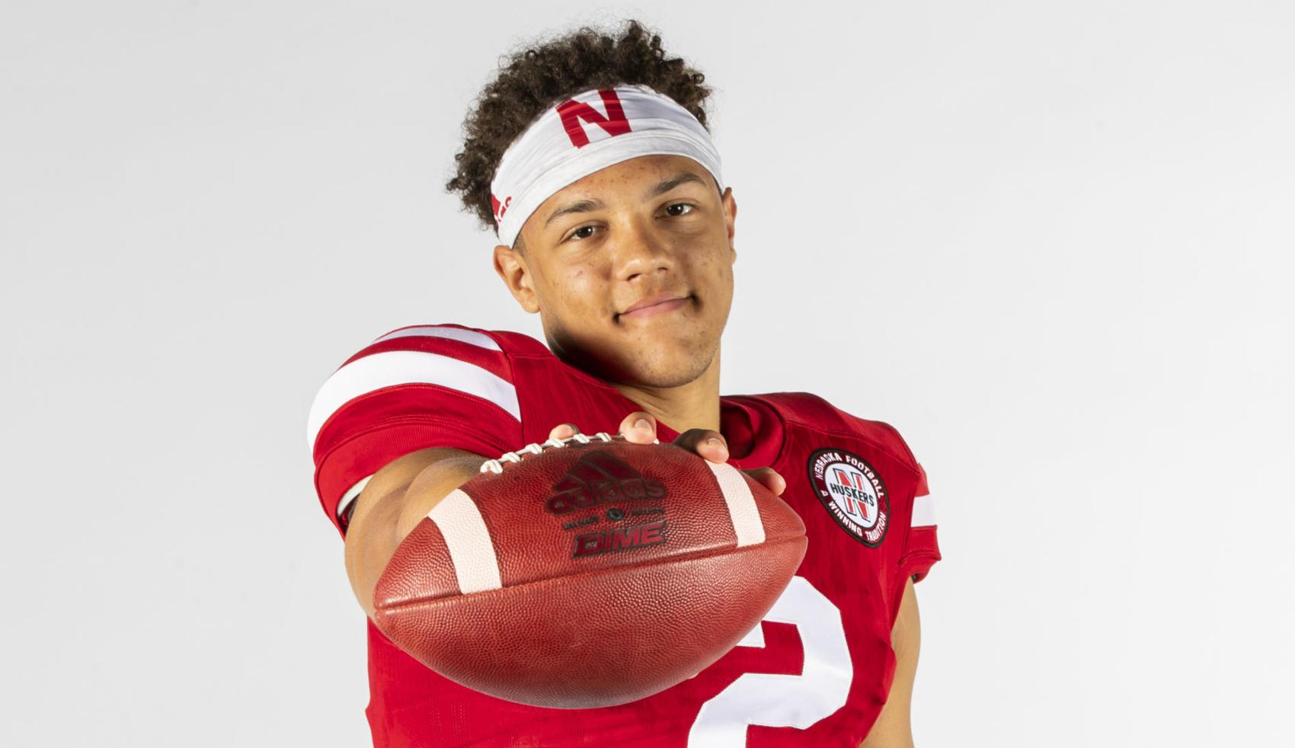

Thank you!
Notes:
With that said, we would like to thank you guys for all the attention with our “MVP” quaterback Martinez from the cornhuskers.

